Slide 1
Predicting Weather in New York City
Ada Jing
Crystal Xu
Jessica Bao
Ruoxin Shi

Slide 2
Agenda
Business Case
Data
Models
Implementation
Results & Next Steps
1.
2.
3.
4.
5.
Real time weather data provides valuable information to make real time decisions based on weather
Data brought in through the Wunderground API
Determined logistic regression to be the most accurate for predictions
Data is received and once enough has been received, models predict various weather information
Next steps include increasing scope, scalability, and exploring further models
Notes:
Being able to predict weather can be valuable for several applications, such as predicting demand for ride share apps
Wunderground is a weather app that provides real-time weather information. Data is for NYC from 2015 to 2016

Slide 3
Real Time Weather Forecasting
Recent Data
Predicting Weather
Weather can change seemingly instantly; using as recent data as possible to make predictions increases accuracy
Predict various information about weather, including probabilities of rain and snow, precipitation levels, and humidity
Weather
Forecast
Real Time Value
Data from API
Accurate weather predictions impact various industries (ex: rideshare and airlines)
10k rows of detailed hourly NYC data of various weather conditions from 12/31/15 to 12/31/16
Notes:
https://www.kaggle.com/meinertsen/new-york-city-taxi-trip-hourly-weather-data

Slide 4
Sample of Wundergrounds API Data
Raw weather data in NYC 12/31/15 - 12/31/16
Weather data with preliminary processing
Timestamp | Rain | Snow | Humidity | Precipitation | …
12/31/15 0:15 | 1 | 0 | 89 | 4.6 | …
12/31/15 0:42 | 0 | 0 | 89 | 0
12/31/15 0:51 | 0 | 0 | 89 | 0
12/31/15 1:51 | 0 | 0 | 90 | 0
12/31/15 2:51 | 0 | 1 | 90 | 3
12/31/15 3:28 | 0 | 0 | 89 | 0
12/31/15 3:40 | 0 | 1 | 86 | 3.2
12/31/15 3:51 | 0 | 1 | 86 | 4.6
Timestamp | Rain | Snow | Humidity | Precipitation | …
12/31/15 0:00 | 1 | 0 | 89 | 4.6 | …
12/31/15 1:00 | 0 | 0 | 89 | 0
12/31/15 2:00 | 0 | 0 | 89 | 0
Date- Hour
Maintained Binary
Average

Slide 5
Variables Used In Predicting
Quantitative
11
Categorical
12
Cleaning
Temperature (F°)
Dewpoint (F°)
Humidity (%)
Wind speed (mph)
Wind gust (mph)
Visibility (miles)
Pressure (inHg)
Precipitation (inches)
Date (year, month, day)
Time (hour, minute)
Wind direction (degrees)
Conditions (light rain, overcast)
Icon (rain, cloudy)
Fog
Rain
Snow
Hail
Thunder
Tornado
Drop N/A values for temperature, dew point, humidity, windspeed, visibility, and pressure
Fill N/A with 0 for wind gust and precipitation
Shift target variable by one timestamp so previous row of data used to predict it

Slide 6
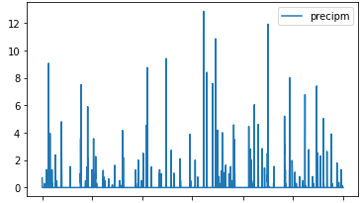
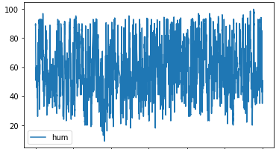
Model – Time Series
Precipitation
Humidity
MSE:
0.36
MSE:
7.8
Predicted Precipitation
Predicted humidity (%)

Slide 7
Model - Logistic Regression
Prediction for Rain and Snow
Pre-trained model – saved in SAV file
Use SMOTE to do data augmentation for better prediction result.
Predictors: [dewpti, hum, precipi, pressurei, tempi, visi, wdird, wgusti, wspdi]
Target: [rain, snow]
Train-test validation. 70:30

Slide 8
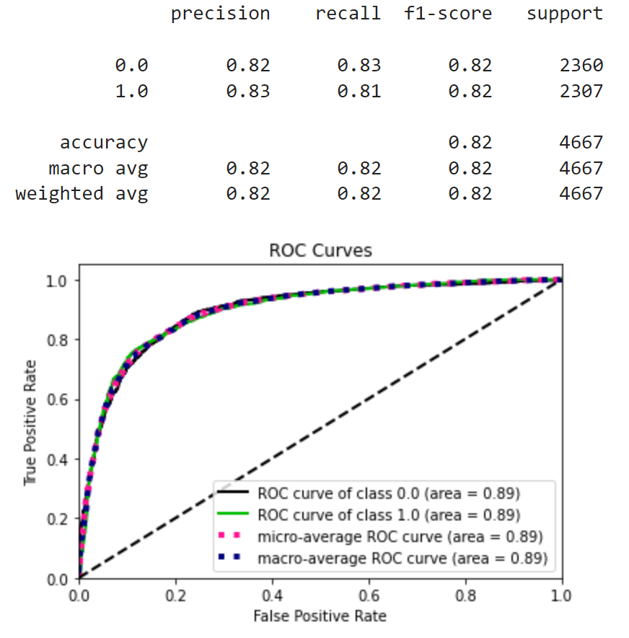
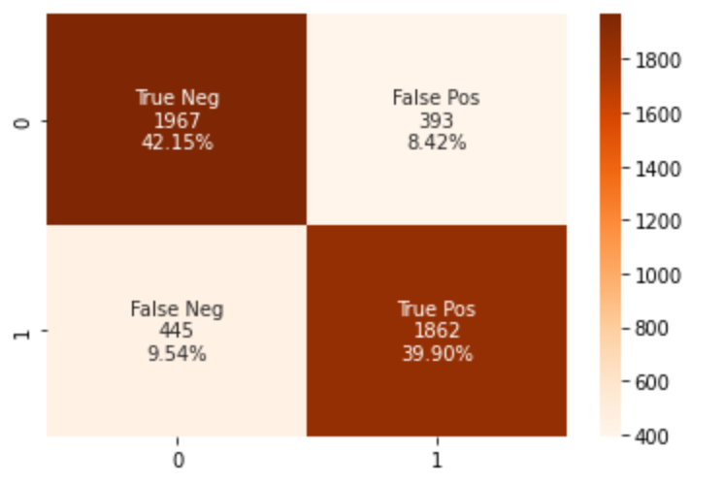
Model - Logistic Regression
Rain
Accuracy:
82.04%
Probability of rain
Notes:
Ruoxin

Slide 9
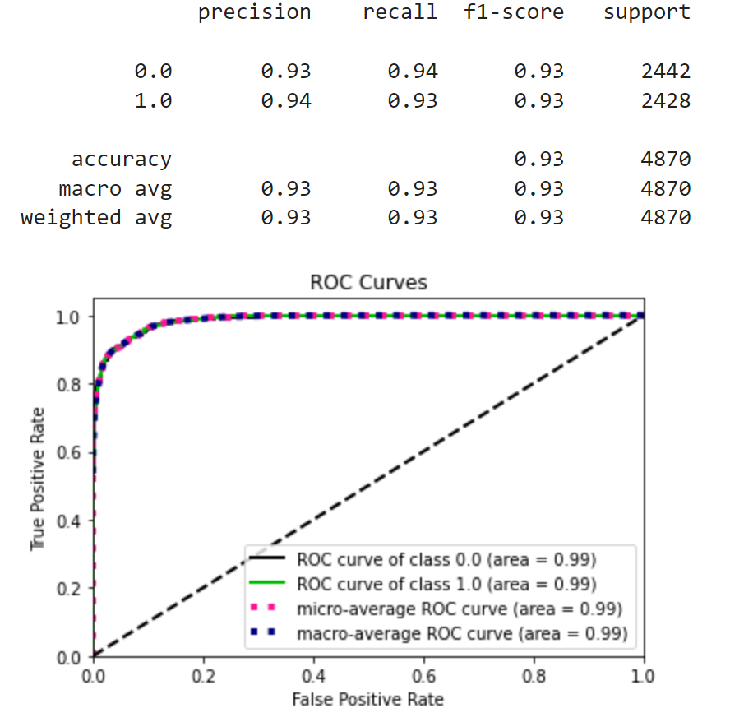
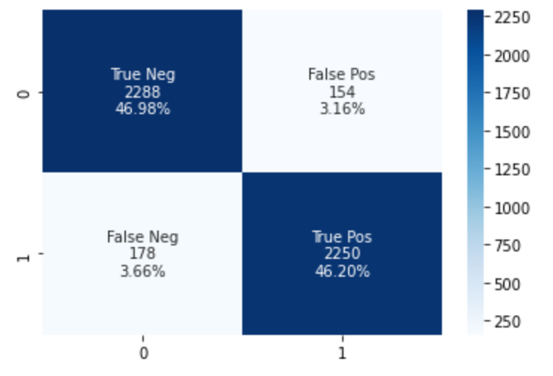
Model – Logisitic Regression
Snow
Accuracy: 93.18%
Probability of snow
Notes:
Ruoxin

Slide 10
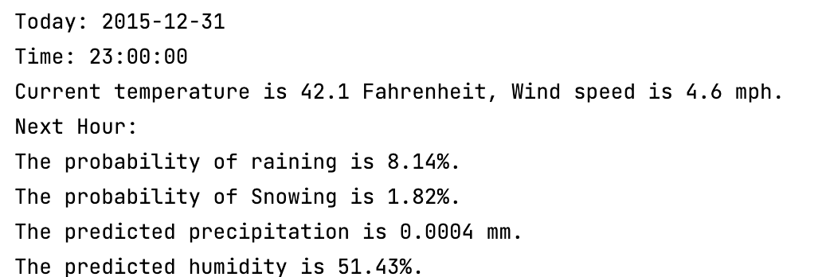
Implementation
Parser
Prediction
Server
Data Cleaning
Model 1 - Rain
Sends real-time weather data
Report
2015-12-31
23:00
Model 2 - Snow
42 ° F
4.6 mph
51.4%
Multithreading
Model 3 - Precipitation
8.14%
1.82%
0.0004 mm
Model 4 - Humidity
Users
Initialize the prediction with a specific model name, load model, select feature, and make the prediction
Summarize the predicted results from each model and format output as desired
Notes:
Crystal

Slide 11
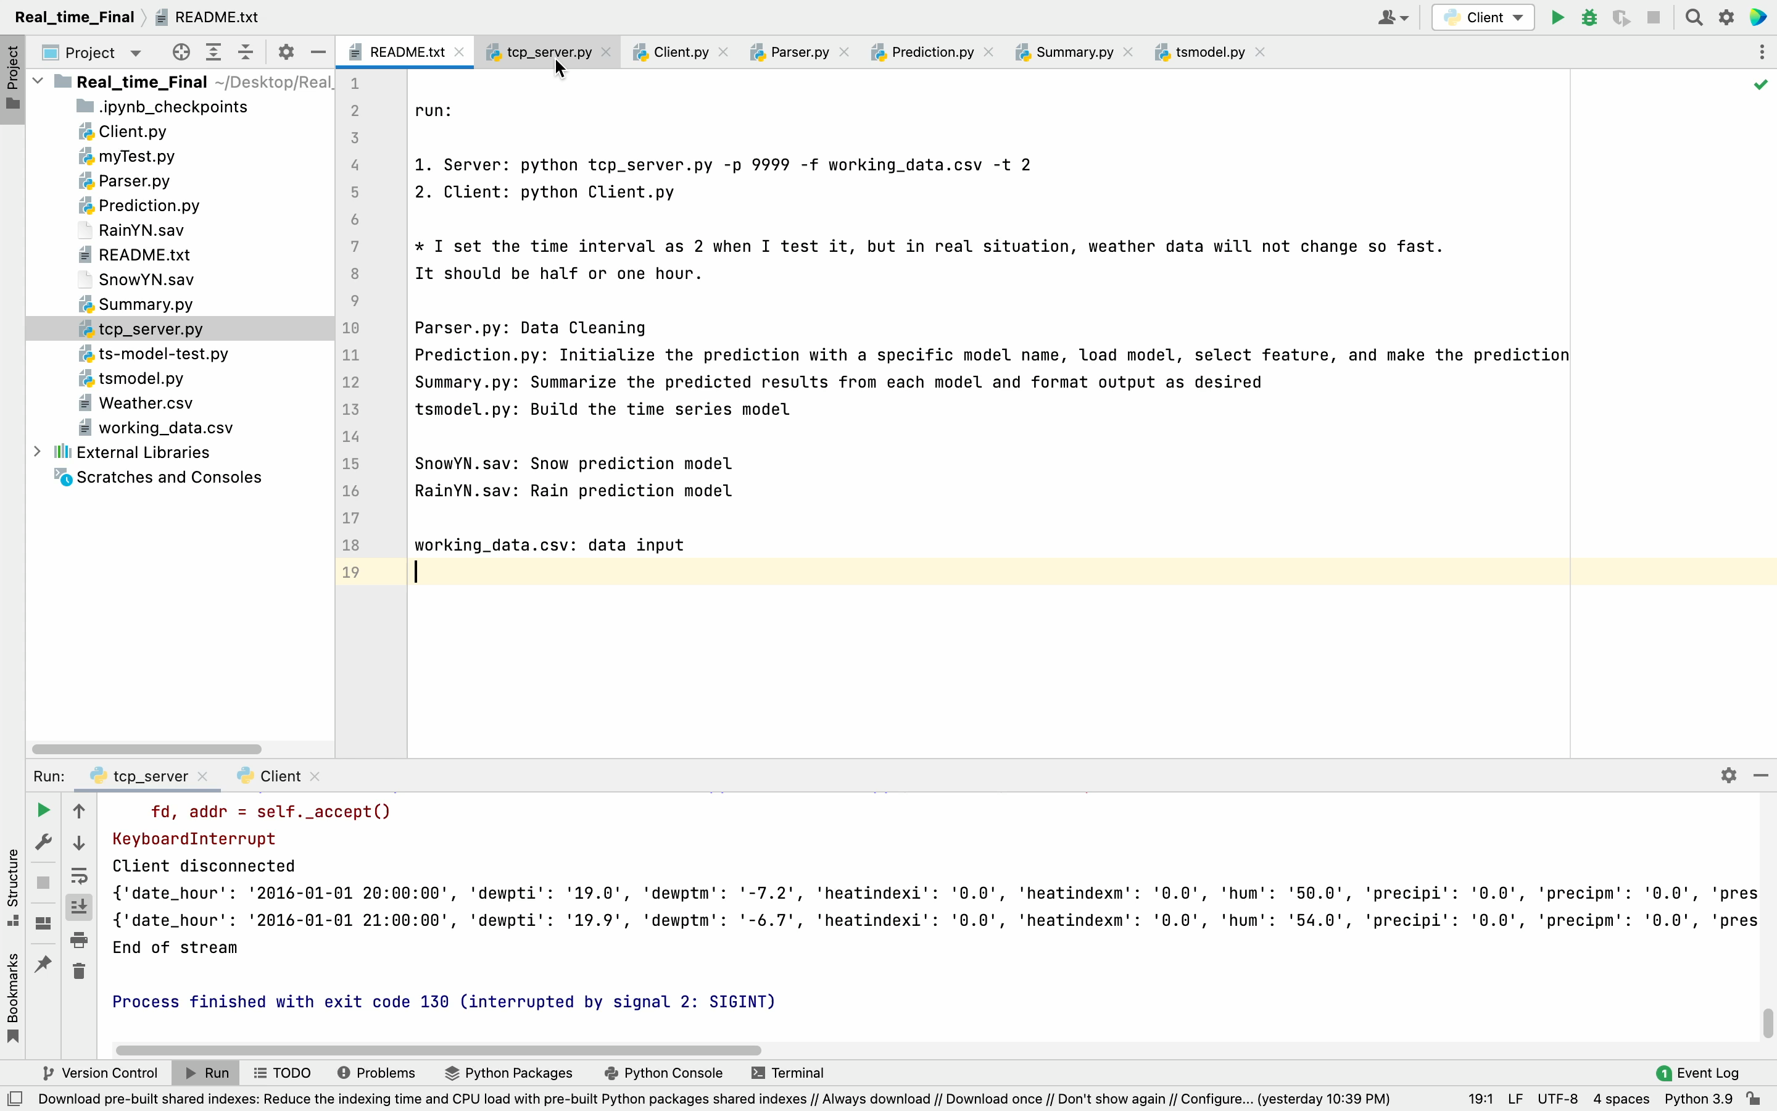
Demo
Notes:
Crystal

Slide 12
Summary and Next Steps
What’s next?
Summary of Output
Next Steps
Hourly predictions and summary of current weather conditions
Scalability
Predictions: probability of rain and snow, precipitation level, and humidity percentage
Advanced models
Additional variables, increase time frame
Notes:
Scalability: expand to beyond NYC
Advanced model: neural networks
Additional variables (wind speed/direction, visibility, conditions). Time until rain starts or stops
Increase time frame: currently predicting for next hour; if model refined, can make further out predictions

Slide 13
Thank you!
Slides credit to slidesgo.com

